Slide 1
Caring for the Carer
How to sustain the privilege of caregiving
Notes:
Carer is a British term for caregivers. Definition – person who cares for those who may have a physical or emotional disability
Who has been a carer? Who is currently caregiving? Who anticipates you will be a carer?
Topic is huge – today, we will focus on
Discussing privilege vs burden of caregiving
Approach to “true self care”
What happens when our loved ones resist our efforts to care
I will use the term carer and caregiver interchangeably

Slide 2
Disclaimer
No financial relationships or endorsement of commercial entities.

Slide 3
Notes:
You have indeed a burden and a privilege – how many of you thought Caregiving is a privilege? Not me
Many of us did not choose to be the designated Carer
E.g. Apostle John being asked to take care of Mary – privilege and a burden
We are a gift to our parents and they are also a gift to us.
As we are stewards to what God has given us – we are to be stewards when it comes to the people God placed in our lives. Not because of culture, not because of social norms – but because we are God’s stewards.

Slide 4
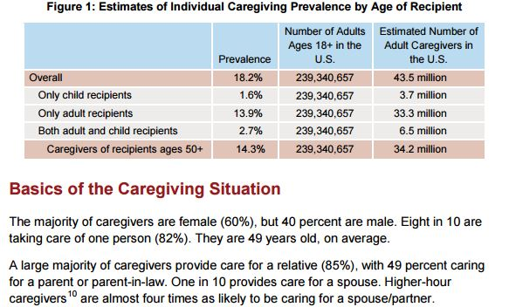
https://www.caregiving.org/wp-content/uploads/2015/05/2015_CaregivingintheUS_Final-Report-June-4_WEB.pdf
Notes:
Many kinds of caregiving – caring for the elderly, for the mentally ill, physically disabled
Researches have been done to study the travails of caregiving and hopefully design programs to address the needs of the population – why? Because we have, are and will be caregivers in one way or another.

Slide 5
As with health status, caregivers in more complex care situations are more likely to report their health has suffered as a result of providing care. These caregivers include those caring for someone with a
mental or emotional health issue (34%),
co-resident caregivers (30%),
providing medical/nursing tasks (27%)
primary caregivers (25%).
White and Asian American (26% and 24%, respectively) caregivers say caregiving has negatively affected their health, significantly more than either African Americans (14%) or Hispanics (15%).
Married women (27%) more often say that providing care has been detrimental to their own health than do unmarried women (16%) or men (20% any marital status).
https://www.caregiving.org/wp-content/uploads/2015/05/2015_CaregivingintheUS_Final-Report-June-4_WEB.pdf
Notes:
How does caregiving affect the carer?
What impresses you from this slide? What stats or statements are sticks out to you?
Without stats, we know stress affects us all physically and emotionally – and often both.
So, what do we do?

Slide 6
Self Care
Notes:
Self care – there are so many different self care tips out there. All Good!
It’s like exercise or my knowledge that Nai Cha is not good for me. I still drink it or that I don’t exercise enough.
They are bandaids to the real problem!

Slide 7
True self-care
is not salt baths and chocolate cake, it is making the choice to build a life you don’t need to regularly escape from.
It often means looking your failures and disappointments square in the eye and re-strategizing. It is not satiating your immediate desires.
It is letting go.
It is choosing new.
It is disappointing some people.
It is making sacrifices for others. It is living a way that other people won’t, so maybe you can live in a way that other people can’t.
~Brianna Wiest
https://thoughtcatalog.com/brianna-wiest/2017/11/this-is-what-self-care-really-means-because-its-not-all-salt-baths-and-chocolate-cake/
Notes:
Does not mean we aim to disappoint people – know and accept that we can’t please everyone all the time
Sacrifice – not necessarily pouring ourselves an sucking it up – but a realistic expectation that sacrifice is part of the equation of a carer.
Key phrase – “making the choice to build a life you don’t need to regularly escape from”
How do we do that?

Slide 8
Ultimate Source
Notes:
When we are stress? Who do you call?
Before we are stressed? Who do you call?
John 15 – abiding in Jesus. Constant source of nutrients to the branches – then we bear healthy fruit.
Without nutrient and part of the branch – we would be like a branch that’s cut off from the tree – it can survive for a little while, but it will die eventually.
e.g. poinsettia from mother in law – broke the flower. Trying to hide it by sticking it in the soil. Eventually it died.

Slide 9
Creative→
Proper Setting
Notes:
Think about the best place to provide care
Home vs facilities
Depending on the needs of the loved one
Depend on your capacity to provide sustainable care
Value of doing vs being

Slide 10
Multi-facet Support
Notes:
Many clts reject help because they feel the resources “can’t help them” = they want a clone who can/will do exactly what they do. All or none mentality
Need to set realistic expectation that the resources, tools and support available may address very specific needs – like tools in a tool chest or your kitchen gadget.
E.g. Pas. Philip taking in garbage can, or one can be the doordash driver, but not the cook!
No one can replace you. Help means lessening your burden.

Slide 11
Indispensable Partnership
Notes:
Many clients also don’t want help because they don’t want to burden others or think they can do it themselves – because it’s their job/calling/responsibility.
As the condition of your loved one change – the weight changes.
Need to evaluate if the condition is a one person job or multiple person job.
E.g. moving a couch. = 2 person job.
Story of the Good Samaritan – he enlisted help of the Inn Keeper.

Slide 12
Encountering Resistance

Slide 13
Seek to Understand
Affirm and Validate Emotions
Provide support to reassure
Initiate Brave Conversations
Be Present and Patient to Prepare

Slide 14
Seek to Understand
Affirm and Validate
Provide support to reassure
Initiate Brave Conversations
Be Present and Patient to Prepare
Reasons behind the resistance
Notes:
Often:
Fear of being abandoned
Fear of being de-valued
Fear of the unknown or change
Their value vs ours – need to be opened up.
From “Why don’t you want ___________? It’s good for you!” to “What do you think would happen if/when we do this?” “What would make it more acceptable to you”?

Slide 15
Seek to Understand
Affirm and Validate Emotions
Provide support to reassure
Initiate Brave Conversations
Be Present and Patient to Prepare
Loved ones emotions. Doesn’t mean you must agree with their perspective or behavior.
Notes:
“I know what you must be feeling. Don’t be scared. No need to feel this way. God is with us, right?”
“Sounds like you are not sure about this” “Must be worrisome to think_________. Tell me more what you are worried about”.

Slide 16
Seek to Understand
Affirm and Validate Emotions
Provide support to reassure
Initiate Brave Conversations
Be Present and Patient to Prepare
That they won’t be abandoned, and you respect their needs.
Doesn’t mean you can and will do exactly as they wish.
Notes:
Don’t worry. I’ll take care of everything. You don’t need to worry about a thing. Just trust me. Trust God!
I hear you. ________ is important to you. I can’t imagine not having this ______too!
Please know that I will be by your side to work this out. No matter what, I am still your _________. Circumstances change, but I will be your ____________ for good! God is with us. We will walk this path together.

Slide 17
Seek to Understand
Affirm and Validate Emotions
Provide support to reassure
Initiate Brave Conversations
Be Present and Patient to Prepare
To share your own physical, emotional and spiritual needs at an appropriate time.
Set limits but offer/discuss alternatives
Prepare to have multiple conversations
Notes:
Don’t you know I’m tired. If you just listen and do what you are supposed to, then it won’t be so hard on me.
I know you don’t want to be [sick] or not able to do _________. It’s hard on you. It’s kind of hard on all of us. I want to be able to take care of you for a long long time, but I need help. I can’t do it alone. I worry that if I get sick, I won’t be able to take care of you. I want to be healthy so I can be with you for the long haul. What would you say if _______________

Slide 18
Seek to Understand
Affirm and Validate
Provide support to reassure
Initiate Brave Conversations
Be Present and Patient to Prepare
Changes and transitions.
Manage realistic expectations
Notes:
Just try it. It’s good for you. It’ll be okay.
In a couple of weeks, this will happen. I will be with you to see how it goes. If it doesn’t work, we’ll go back to the drawing board and figure something out.
What do you think it will be like? How can we make it better?

Slide 19
What’s the takeaway?
Notes:
Caring for others is a privilege given by God. With privilege comes responsibility
The responsibility can be heavy and take a toll on our physical/emotional health.
True self care means a life-style change so we won’t have to feel we need to “escape”
Self includes re-strategizing our approach to caring for others
What are you doing now
What changes do you need to make?
It’s challenging when our loved one “resist” the help. Need to reframe and look at the situation. Communicating in ways they can understand and feel supported is key.

Slide 20
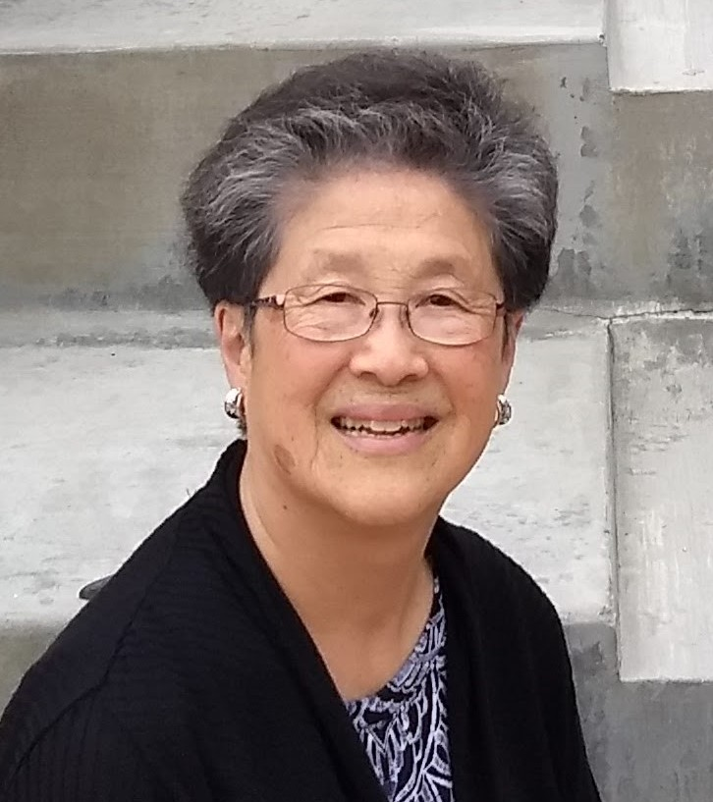
“No one should leave this earth without knowing they’ve been loved.”

Slide 21
Contact Info
Susana Fong, LCSW
sufong@gmail.com

